Slide 1

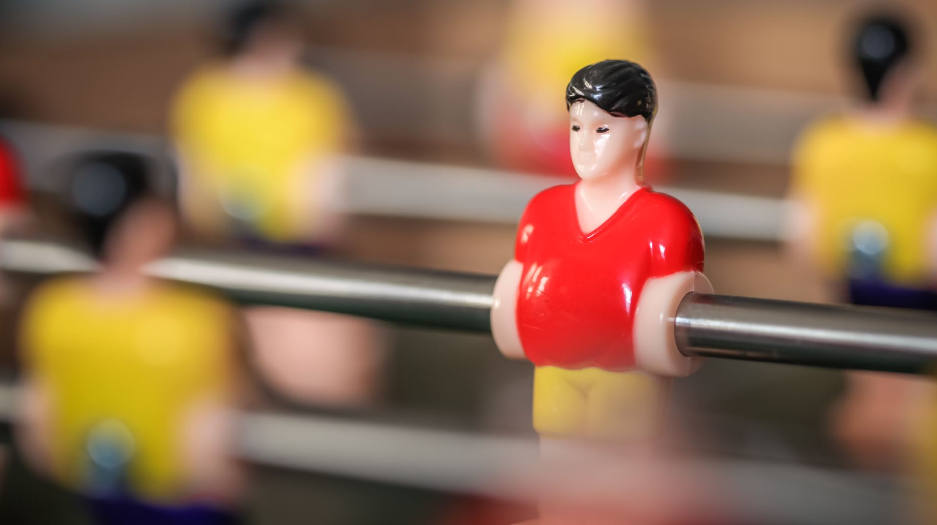
BO, Arcade Mechanics
door Jamie, Rick en Sem

Slide 2

De game
De game
Game art/assets

Slide 3

GitHub
De GitHub repository

Slide 4

Trello
https://trello.com/b/BG9m1RyC/arcade-mechanics-f2m3
Moodboard

Slide 5




Einde

